Slide 1

250
NT
04.20.2024
pandas
Introduction
Caption

Slide 2

Pandas - Introduction
Data Science Program
Session-1

Slide 3


Pandas Lesson Content
Series & Data Frames
Indexing, Slicing & Selection
Groupby & Useful Operations
Handling with Missing_Values
Combining Data Frames
Text & Time Data
What will we learn in Pandas lessons?

Slide 4
Session-1 Content
Pandas Introduction
Pandas Data Types
Pandas Series
Pandas DataFrame
Creating Series- Notebook
What will we learn today?

Slide 5

Have you studied pandas pre-class?

Slide 6
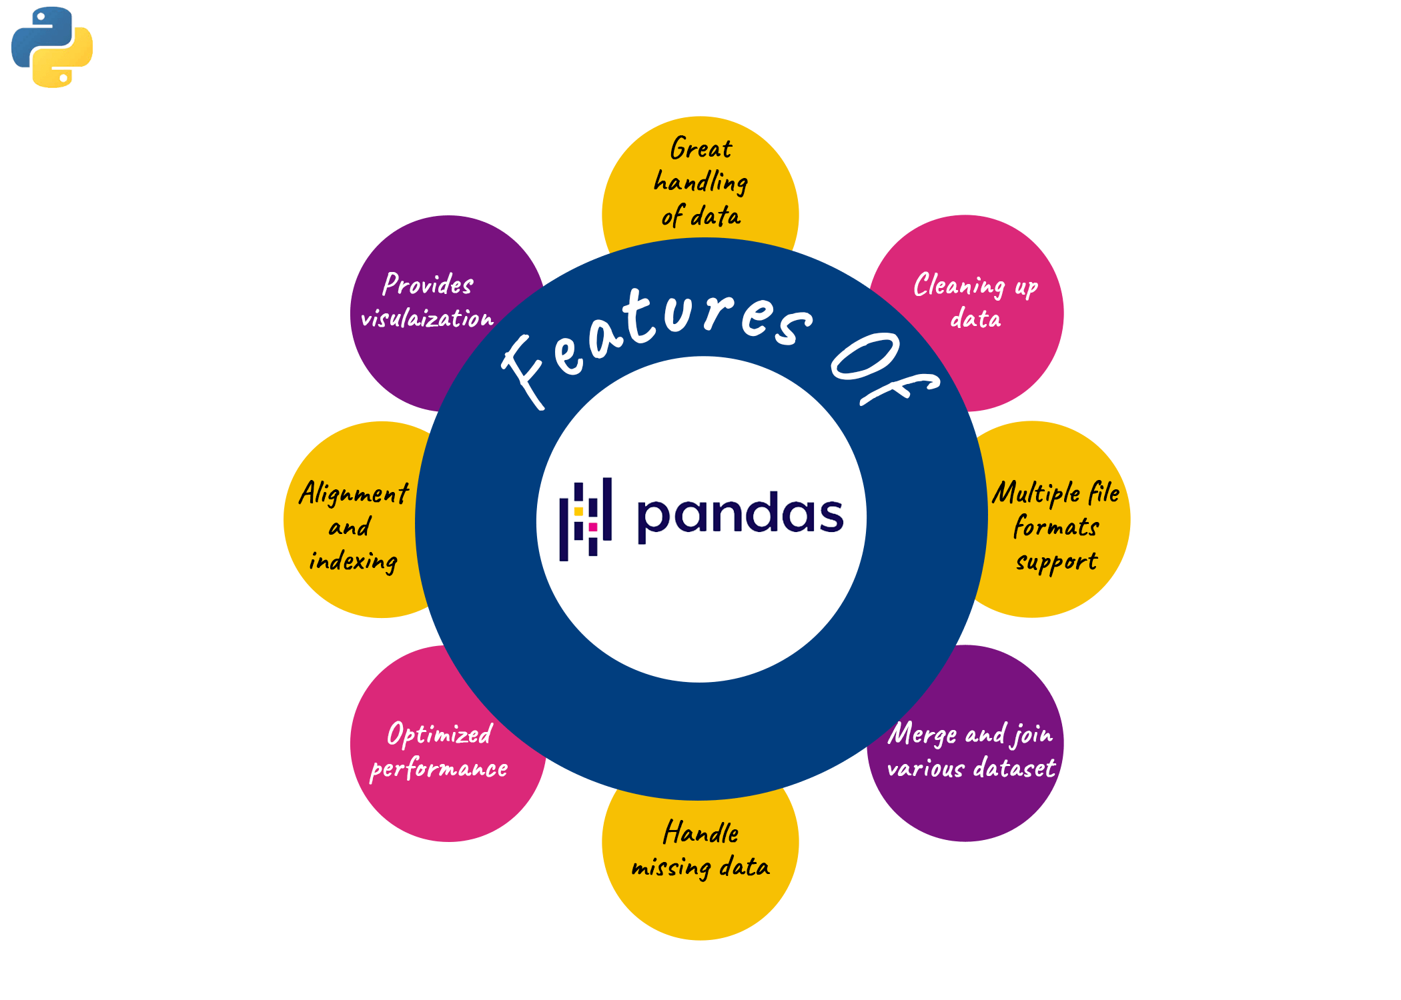
Why Pandas

Slide 7
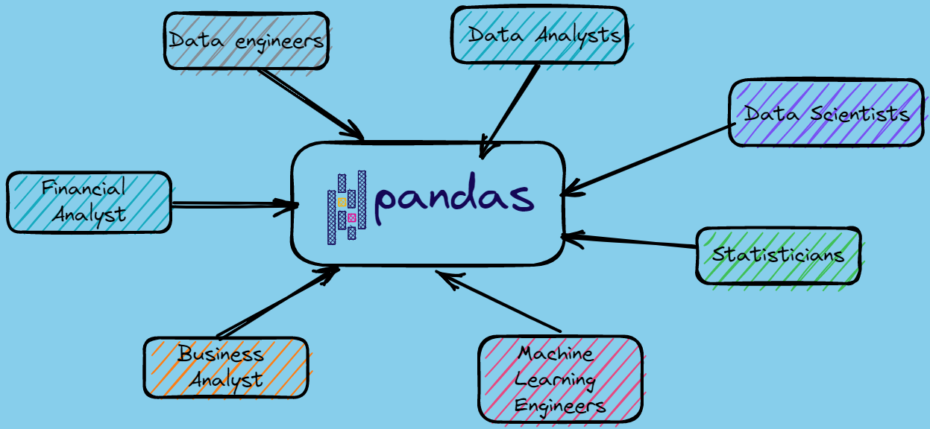
Why Pandas

Slide 8

Pandas
Pandas is an open-source library for data manipulation and analysis in the Python programming language.
Pandas' basic data structures, Series (for one-dimensional data) and DataFrame (for two-dimensional data), are extremely useful and flexible tools.

Slide 9
Pandas
Data cleaning and preprocessing: Filling in missing data, removing erroneous data, changing the format of data, data transformation operations, etc.
Data analysis: Analyzing and summarizing data, performing statistical analysis, feature engineering, etc.
Data visualization: Visualizing data with various graphs to facilitate understanding and interpretation of data.
Machine learning: It is very useful in pre-processing and preparing data to feed the dataset into machine learning algorithms.

Slide 10
Pandas
Pandas = Panel Data System
The Pandas library is an effective tool developed for the Python programming language and used to process many types of data, including panel data.
Panel data is a type of data used in econometrics and statistical analysis.
Panel data refers to data collected over time from multiple subjects or units (e.g. individuals, firms, countries, etc.).

Slide 11
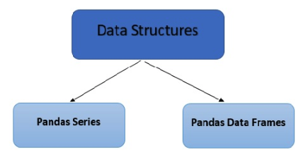
Pandas
Pandas = Panel Data System
However, in practice, the most common use of Pandas is to operate on tabular data with a structure called DataFrame.
Basic data structures we will use when analyzing data with Pandas; Series and DataFrames

Slide 12
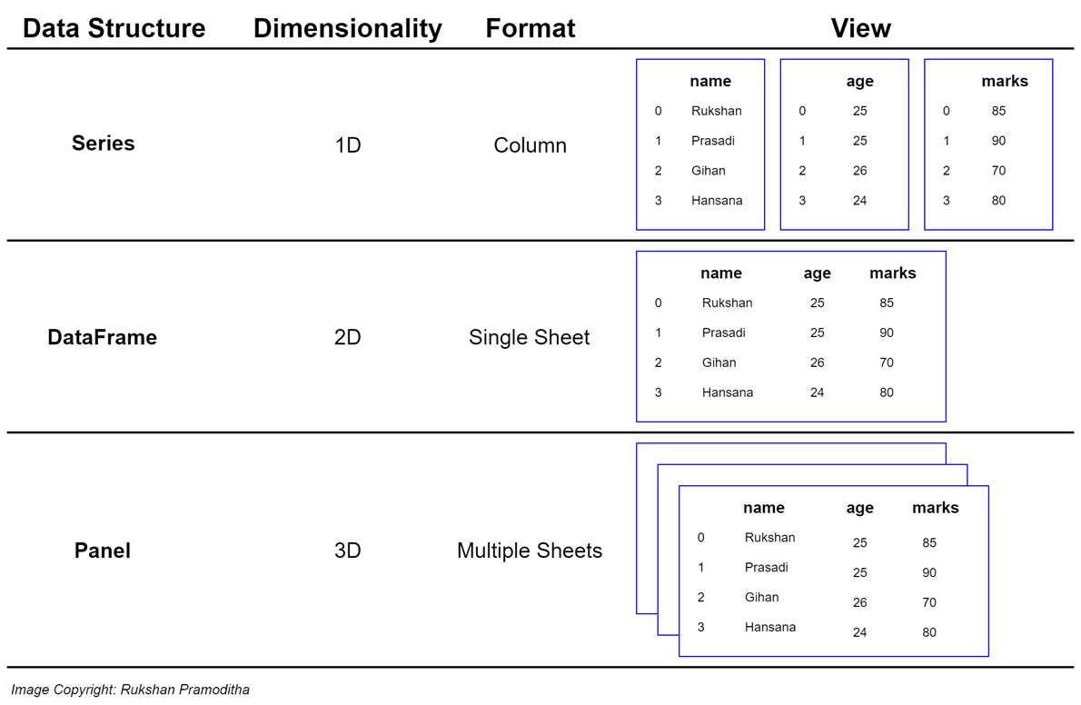
Pandas

Slide 13
Pandas Series
Pandas Series is built on top of NumPy array objects and they are very similar.
It is a one-dimensional labeled array that can hold data of any data type.
Label values are called indexes.
The data itself can consist of numbers, strings, or other Python objects.
Lists, ordered arrays or dictionaries can be used to create series.

Slide 14
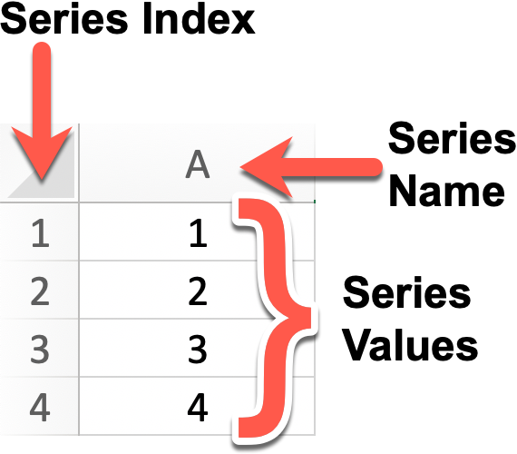
Pandas Series

Slide 15
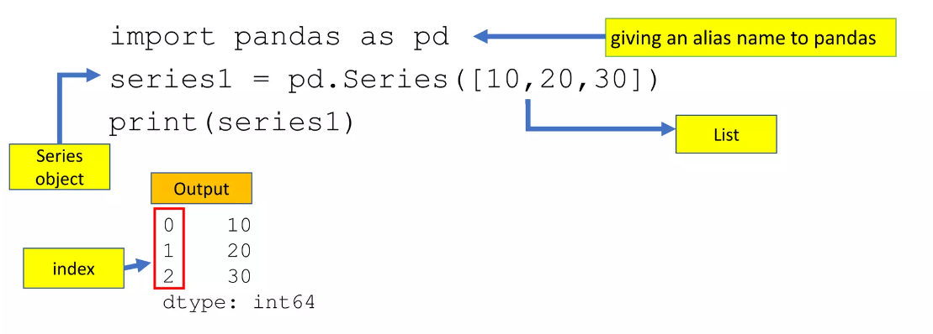
Pandas Series

Slide 16
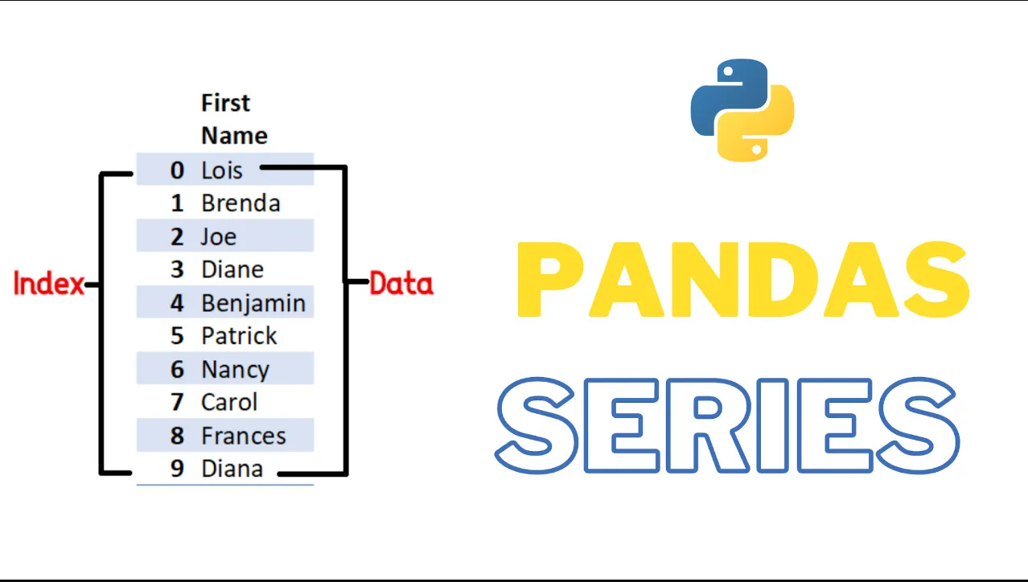
Pandas Series

Slide 17
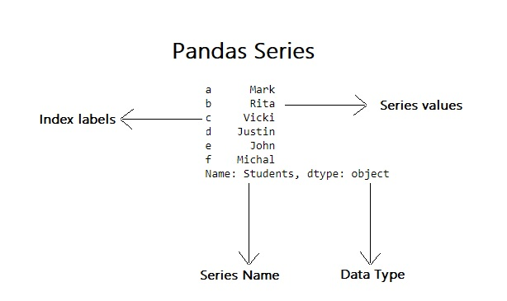
Pandas Series

Slide 18
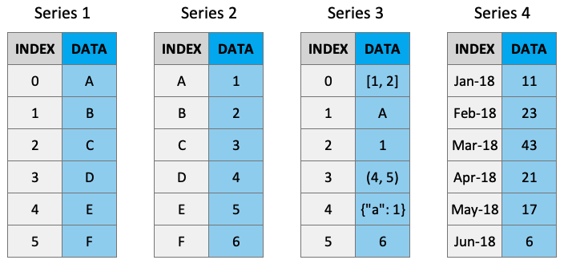
Pandas Series

Slide 19
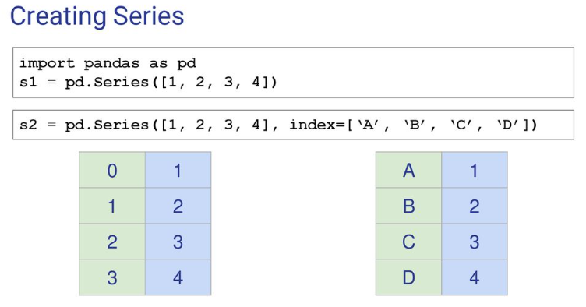
Pandas Series

Slide 20
Pandas DataFrames
Pandas Dataframe is a two-dimensional labeled data structure with rows and columns.
Each column in a Pandas DataFrame is a Pandas Series.
The data itself can consist of numbers, strings, or other Python objects.
Lists, ordered arrays or dictionaries can be used to create series.

Slide 21
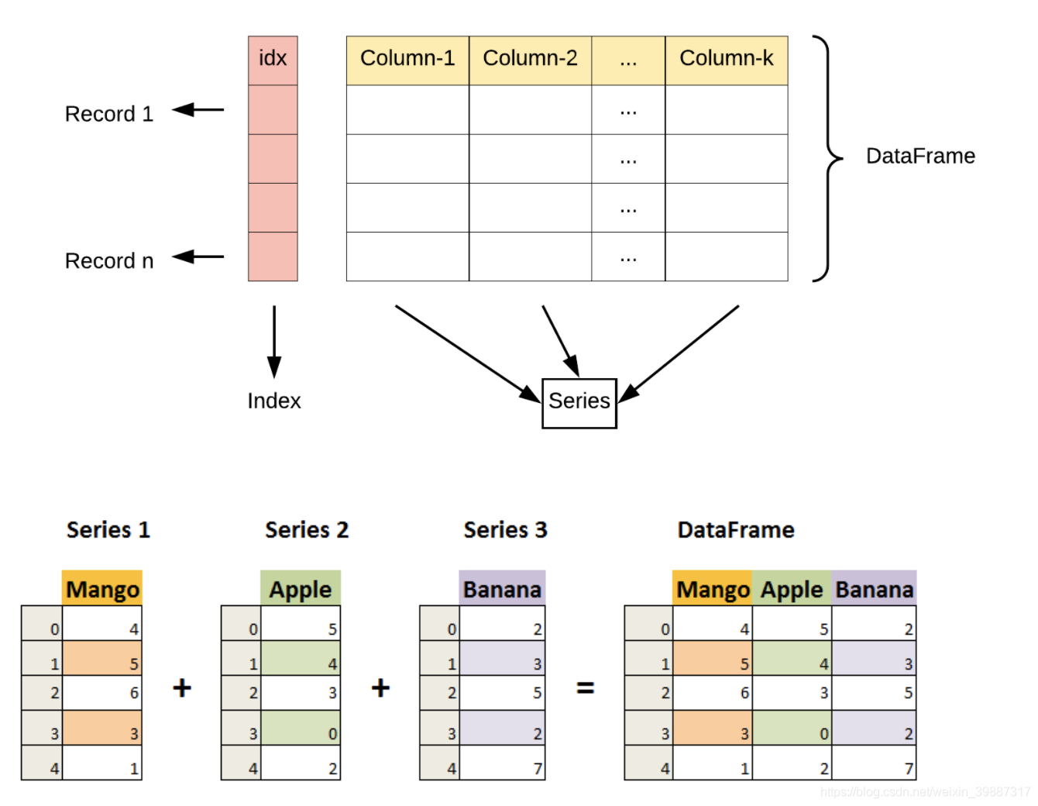
Pandas DataFrames

Slide 22
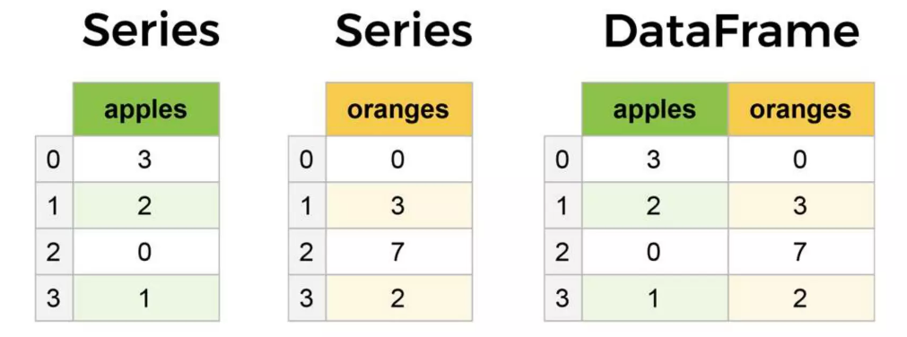
Pandas DataFrames

Slide 23
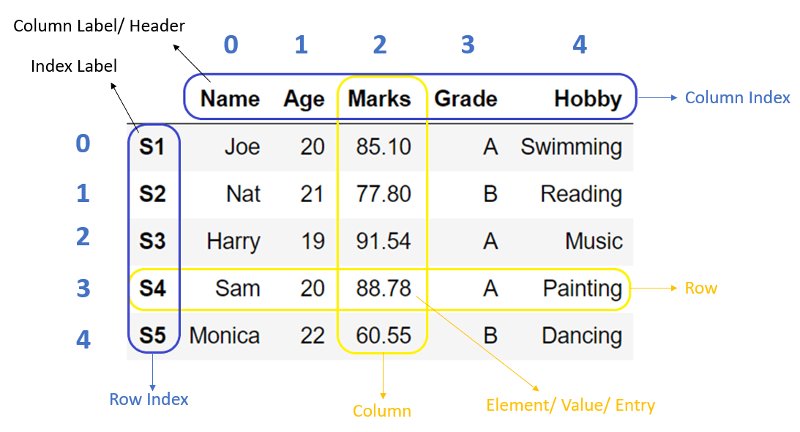
Pandas DataFrames

Slide 24
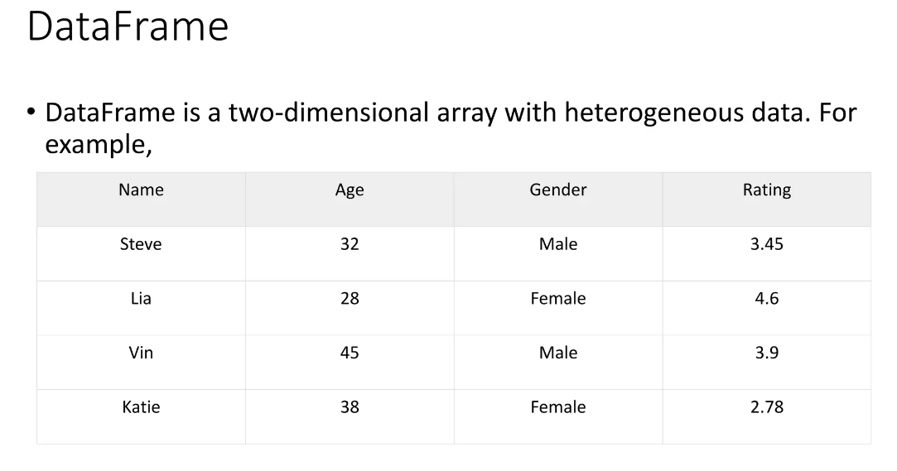
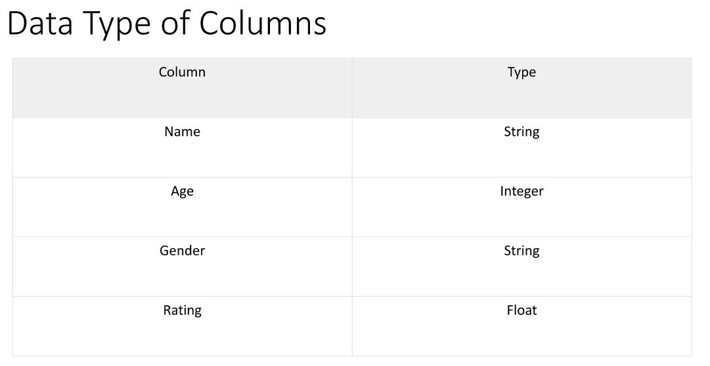
Pandas DataFrames

Slide 25
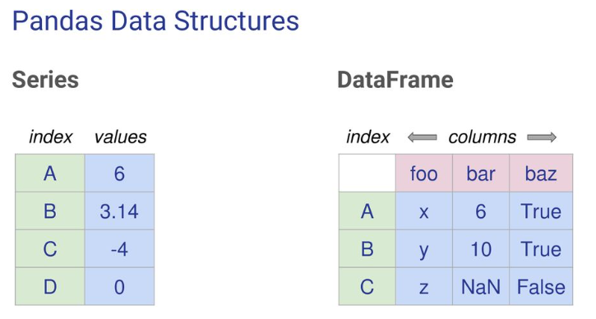
Pandas DataFrames

Slide 26
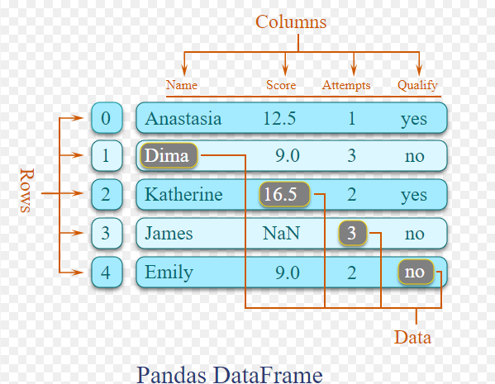
Pandas DataFrames

Slide 27
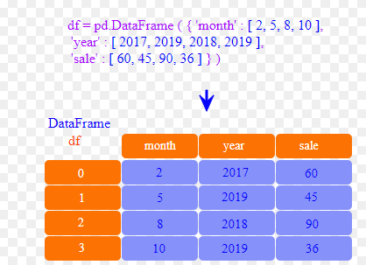
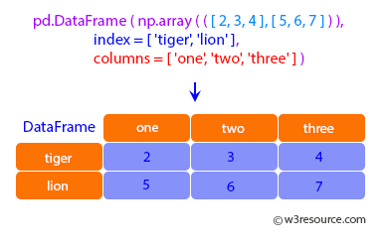
Pandas DataFrames

Slide 28
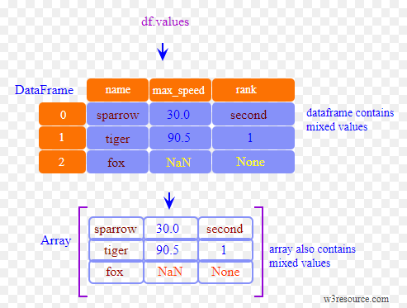
Pandas DataFrames

Slide 29
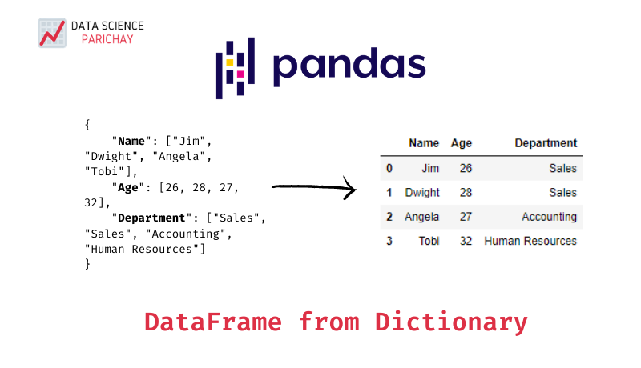
Pandas DataFrames

Slide 30
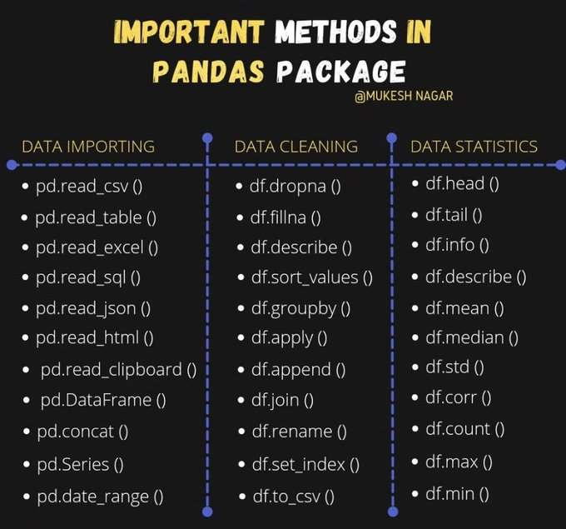
Pandas DataFrames

Slide 31
TIME TO PRACTICE

Slide 32

Do you have any questions?

Slide 33


